Slide 1

Telecom Customer Churn Analysis
Executive Insights & Retention Strategy
10,000 Customers | 6 Months History | Data-Driven Strategy
Prepared by Ayush Anand

Slide 2



Executive Summary
Objective
Scope
Best Model Results
Predict churn, identify key drivers, and recommend targeted retention actions to reduce customer loss.
10,000 customers across 6 months: usage patterns, complaints, recharges, and payment behavior analyzed.
LogisticRegression: ROC-AUC 0.655, F1 0.081, Accuracy 63.6%—solid foundation for segmentation.
Four Strategic Segments Identified: At Risk (257), Loyal (2,328), Dormant (monitor), and Needs Attention (7,415). Focus: win-back campaigns, complaint resolution, and value-driven retention.

Slide 3
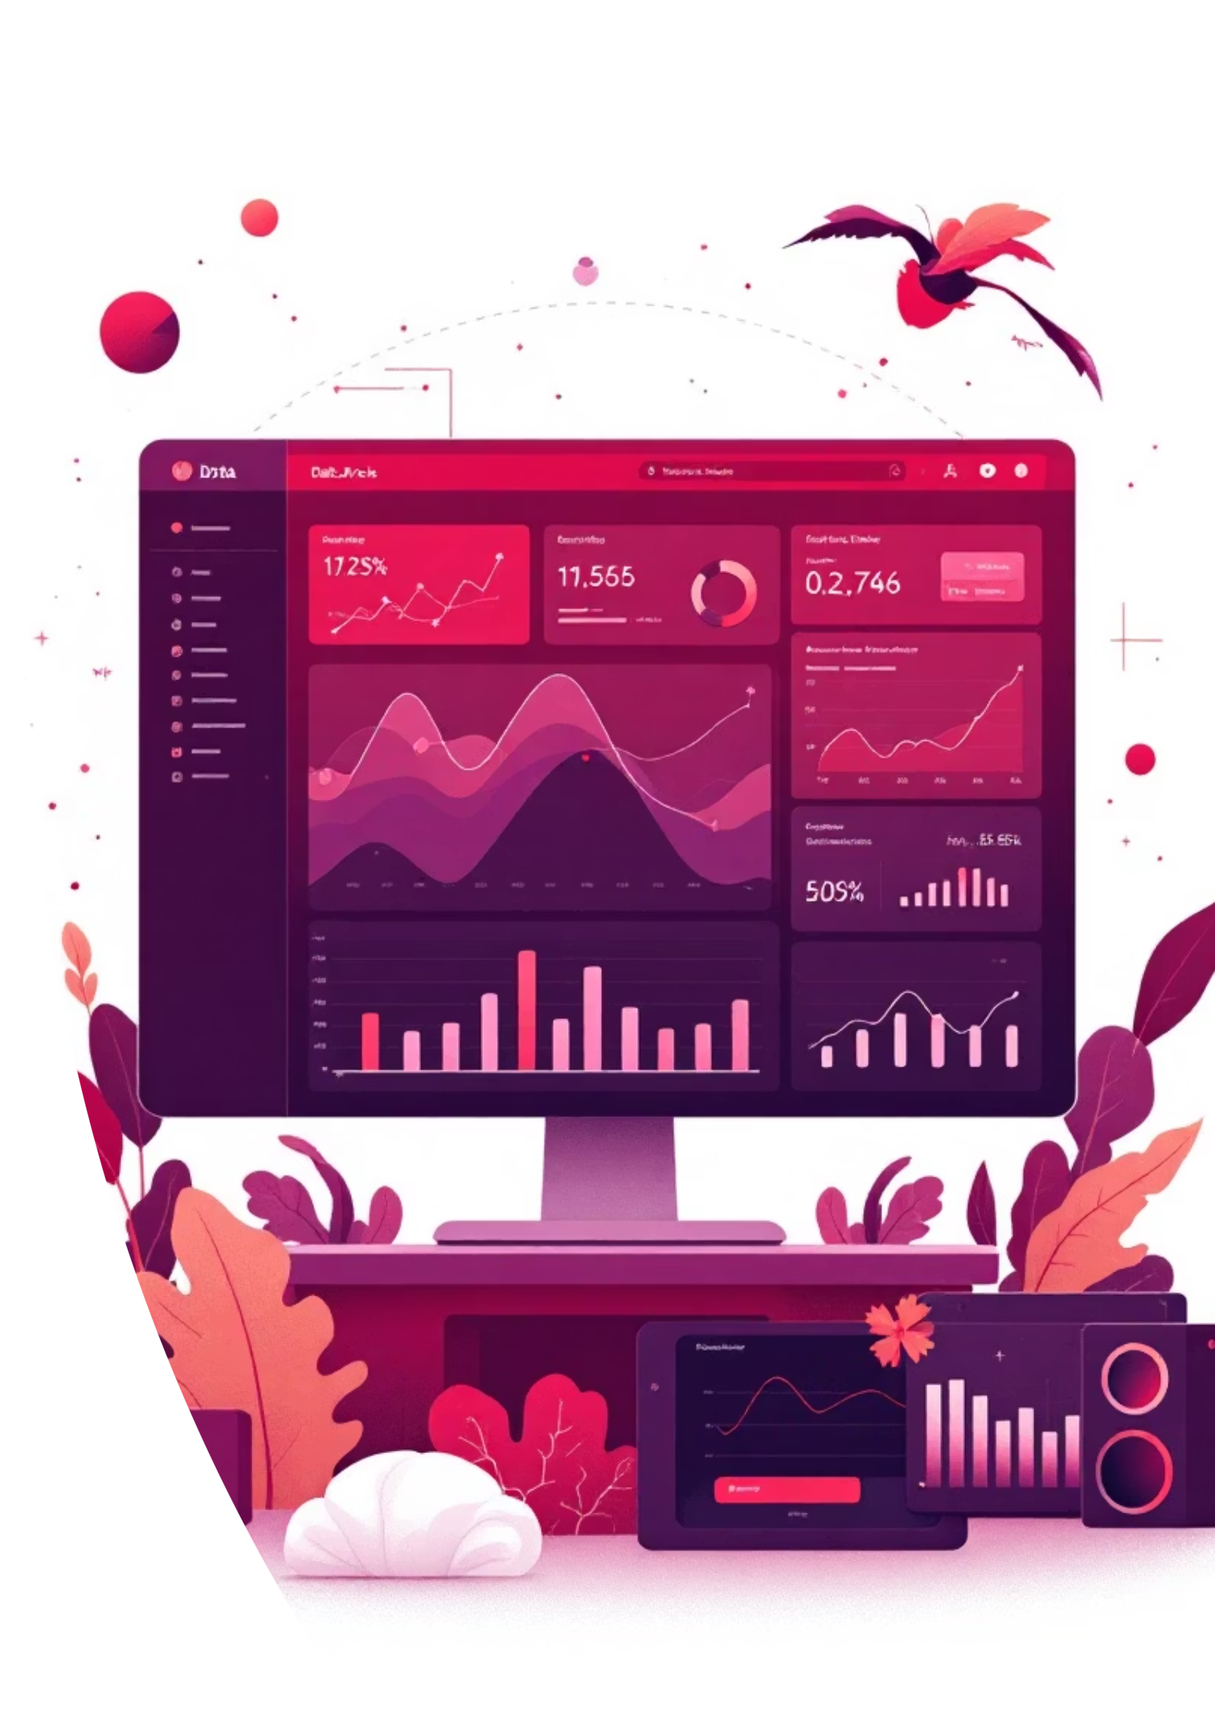
Methodology – Data & Machine Learning
Data Foundation
Modeling Approach
Demographics, call records, recharge history, complaint logs, and payment behavior. Engineered features include recency triggers, usage trends, complaint intensity, and payment discipline metrics.
Ensemble methods (RandomForest, LogisticRegression, XGBoost) with stratified K-fold validation and GridSearchCV optimization. SHAP and ELI5 explainability for stakeholder clarity.
Key Innovation: Deterministic seeds and reproducible artifacts ensure confidence in predictions and enable rapid iteration.

Slide 4

Key Insights – Drivers & Patterns
Activity Recency Dominates
Days since last call or recharge is the strongest risk signal. Implement immediate notification triggers for 30+ day inactive users.
Recharge Behavior Matters
Lower transaction count and inconsistent recharge amounts correlate with higher churn. Frequency and stability are reliable indicators of engagement.
Recent Complaints Drive Risk
Complaints within 30 days elevate churn risk significantly. Network and billing issues are top drivers across regions—prioritize rapid resolution.
Payment Discipline Signals Health
On-time payment ratio strongly correlates with retention. Promote AutoPay, clear grace periods, and transparent billing to reduce friction.

Slide 5
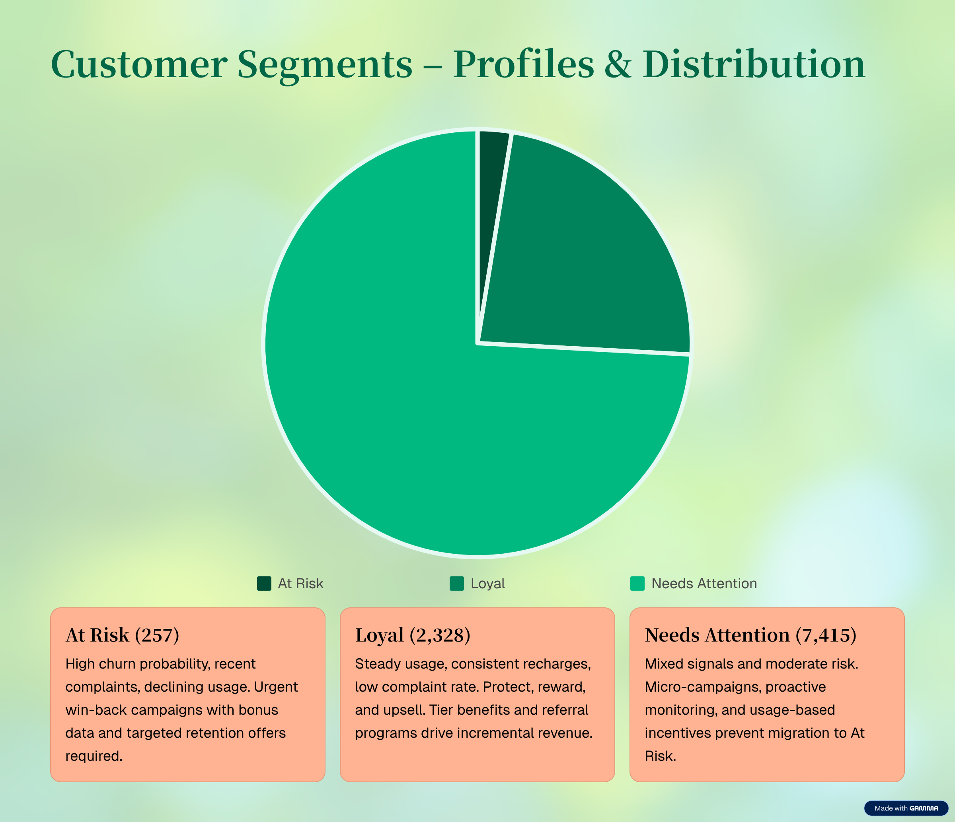
Customer Segments – Profiles & Distribution

Slide 6



Retention Strategies – Targeted Playbooks
Immediate (0–30 Days)
Win-back for At Risk: bonus data and cashback. Service recovery for complainers with fast-track SLAs. Recharge nudges with low-friction offers.
Medium Term (1–3 Months)
Loyalty boosters for Loyal segment. Usage-based incentives for low-ARPU users. Regional complaint hotspot fixes and UX improvements.
Long Term (3–6 Months)
Flexible bundles, family sharing, and retention perks. Predictive CRM with next-best-action triggers. VoC/NPS feedback loops drive continuous improvement.
Track Impact via: Churn rate reduction, reactivation rate, ARPU uplift, complaint resolution, NPS improvement, and segment migration to Loyal.

Slide 7
Implementation Roadmap – Timeline & Execution
Phase 1: Launch (Weeks 1–2)
1
Deploy At Risk win-back and complaint recovery SLAs. Owners: Retention Marketing, Customer Care. Target: +X% recharges, −Y% complaints >72h open.
2
Phase 2: Scale (Weeks 3–8)
Loyalty boosters and usage incentives pilots with A/B testing. Owners: Product, Marketing Analytics. Target: ARPU +X%, churn delta −Y% vs control.
Phase 3: Industrialize (Weeks 9–16)
3
CRM predictive triggers and automated dashboards. Owners: Data/Engineering, CRM Ops. Target: alert precision/recall ≥ thresholds, SLA ≥ target.

Slide 8
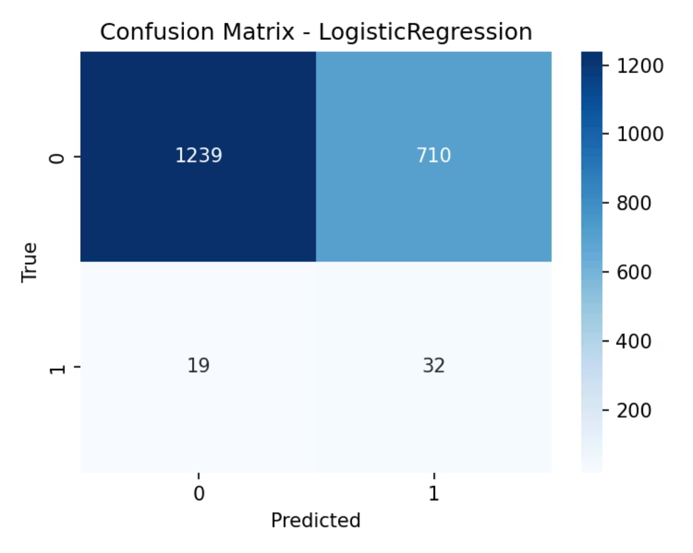
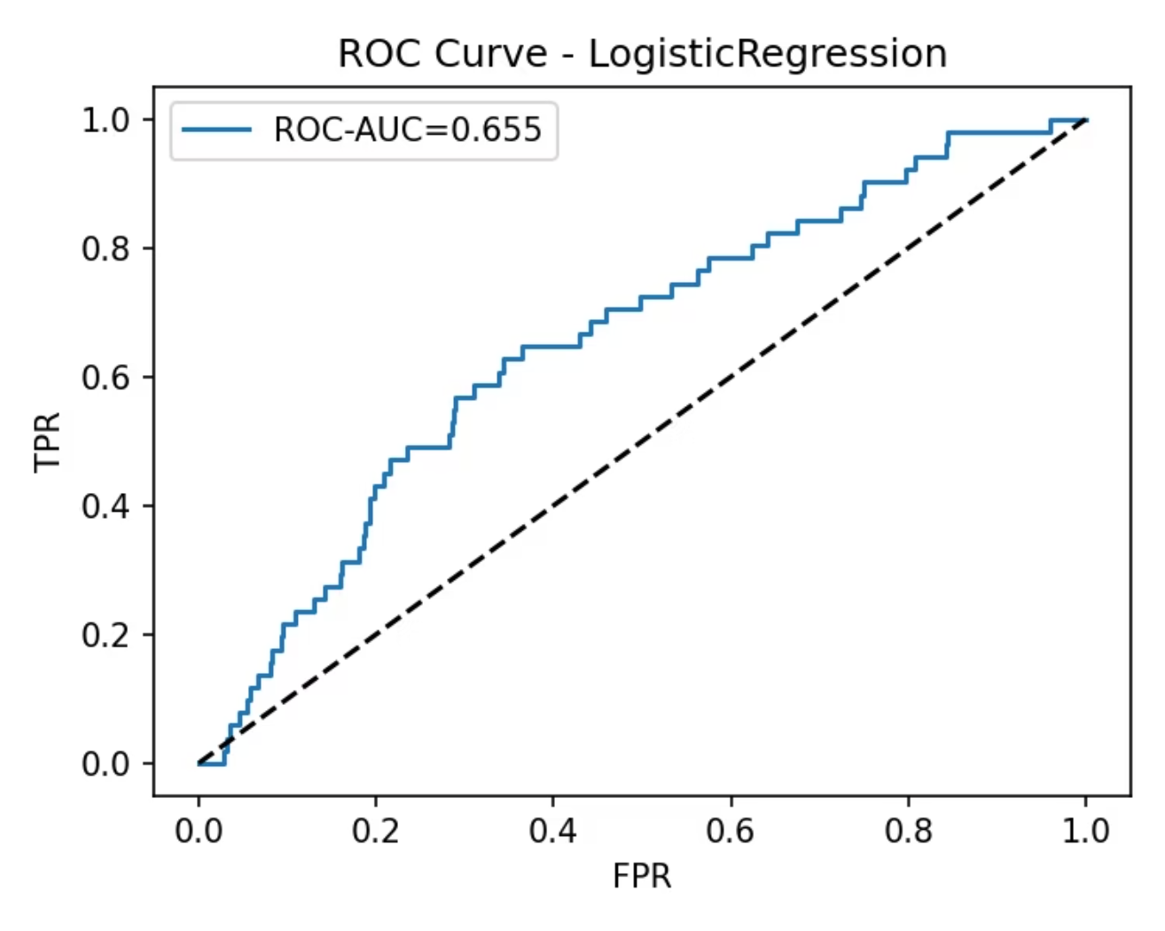

Model Performance & Validation
ROC-AUC: 0.655 indicates robust differentiation between churners and non-churners, even with class imbalance. Higher thresholds favor recall; lower favor precision.
Confusion Matrix reflects class imbalance (63.6% non-churners). Accuracy alone can be misleading; focus on F1 and recall for business decisions.
Key Caveat: Business thresholds can be tuned for recall/precision trade-off. Threshold 0.5 shown; operational deployment requires stakeholder alignment on false positive vs. false negative costs.

Slide 9

Risk Mitigation & Monitoring
Cannibalization Risk
Campaign Fatigue
Strict eligibility rules and holdout control groups prevent cannibalizing revenue. Cap incentive frequency and value per customer cohort.
Implement frequency caps and opt-down options. Monitor engagement metrics and adjust messaging cadence based on response rates.
Data Drift
Monthly retraining and monitoring cadence ensures model stays aligned with evolving customer behavior and market dynamics.

Slide 10

Next Steps & Call to Action
This analysis provides a data-driven foundation for a retention-focused transformation. Strategic implementation across all three phases will drive measurable churn reduction and revenue protection.
Week 1 Priorities
Stakeholder Alignment
Finalize At Risk segment targeting list and win-back offer design. Brief Customer Care on complaint recovery SLAs and escalation paths.
Confirm budget, ownership, and success metrics across Retention Marketing, Product, and CRM Operations. Establish steering committee for weekly reviews.
Continuous Learning
Build feedback loops, track KPIs in real-time, and adapt playbooks based on early results. Monthly model reviews ensure lasting competitive advantage.

